Slide 1
Computer Graphics and Game Systems
DAC415
<Rowan Morley-Stanton>
<Diogo Lapa>
<Jordan Herbert>

Slide 2
Rowan’s Asset & Texture List
-Assets
Coolant Cell
Crate
Door
Door Frame
-Textures
Coolant Texture
Sci-fi door texture
Neon Crate Texture

Slide 3
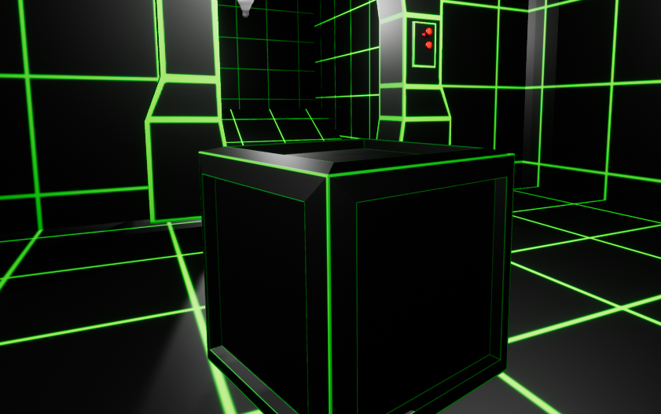
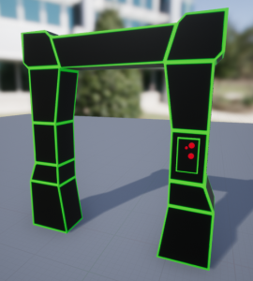
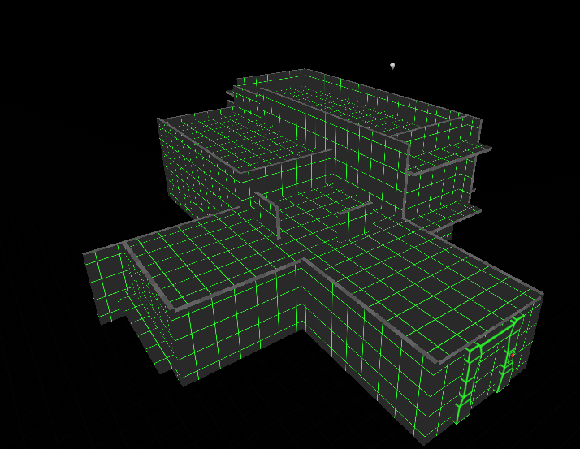
Rowan’s 3D Models

Slide 4
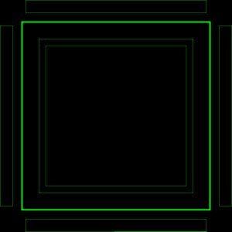
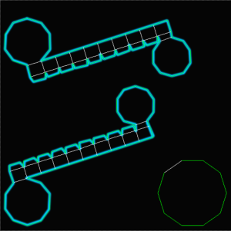

Rowan’s Textures & Materials

Slide 5
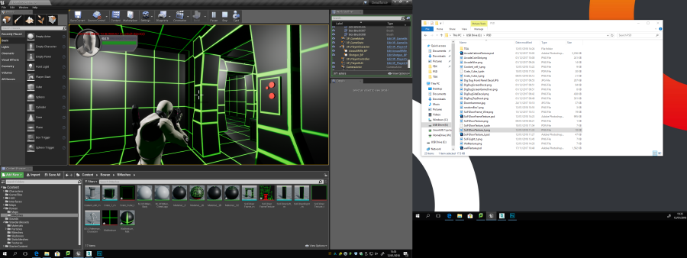
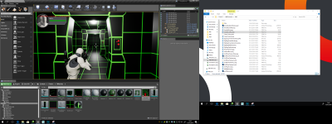
Rowan’s Section In-Game Screenshots

Slide 6
Diogo’s Asset & Texture List
- Assets
Turret
Fuse Box
Ladder
-Textures
FuseBox Texture
Ladder Texture
Turret Texture

Slide 7
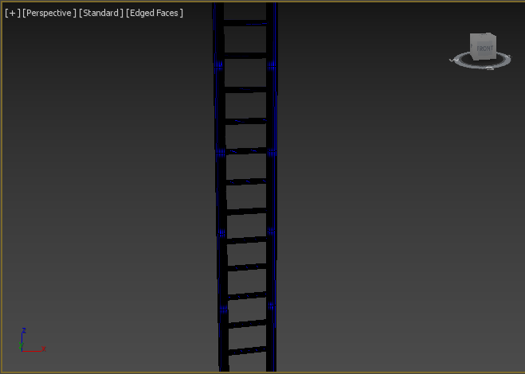
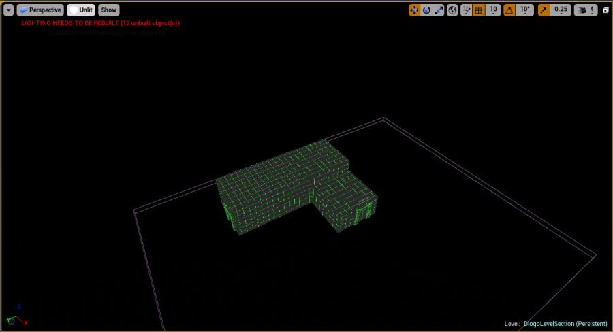
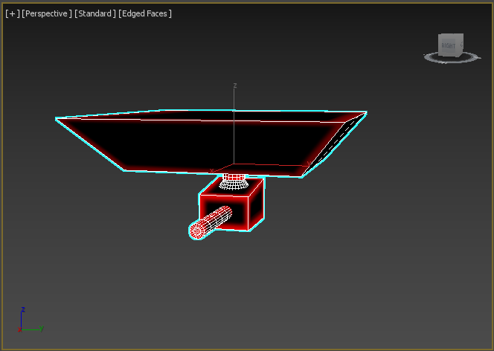
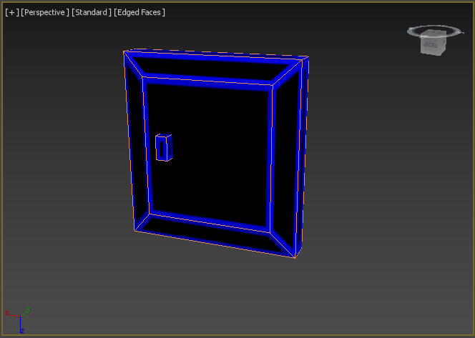
Diogo’s 3D Models

Slide 8

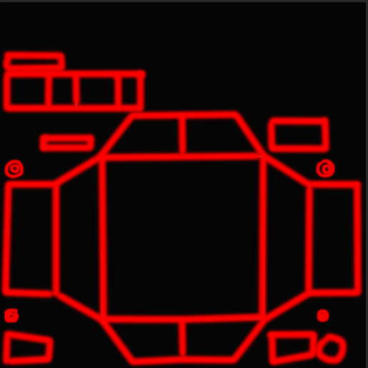
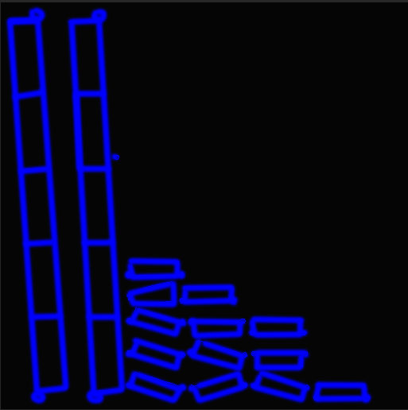
Diogo’s Textures & Materials

Slide 9
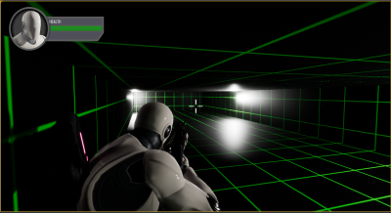
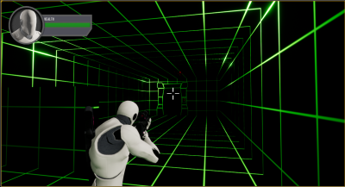
Diogo’s Section In-Game Screenshots

Slide 10
Jordan’s Asset & Texture List
-Assets
Keycard
Keycard slot
Desk
Chair
Cover
-Textures
Neon Wall texture
Neon Cover Texture
Keycard Texture

Slide 11
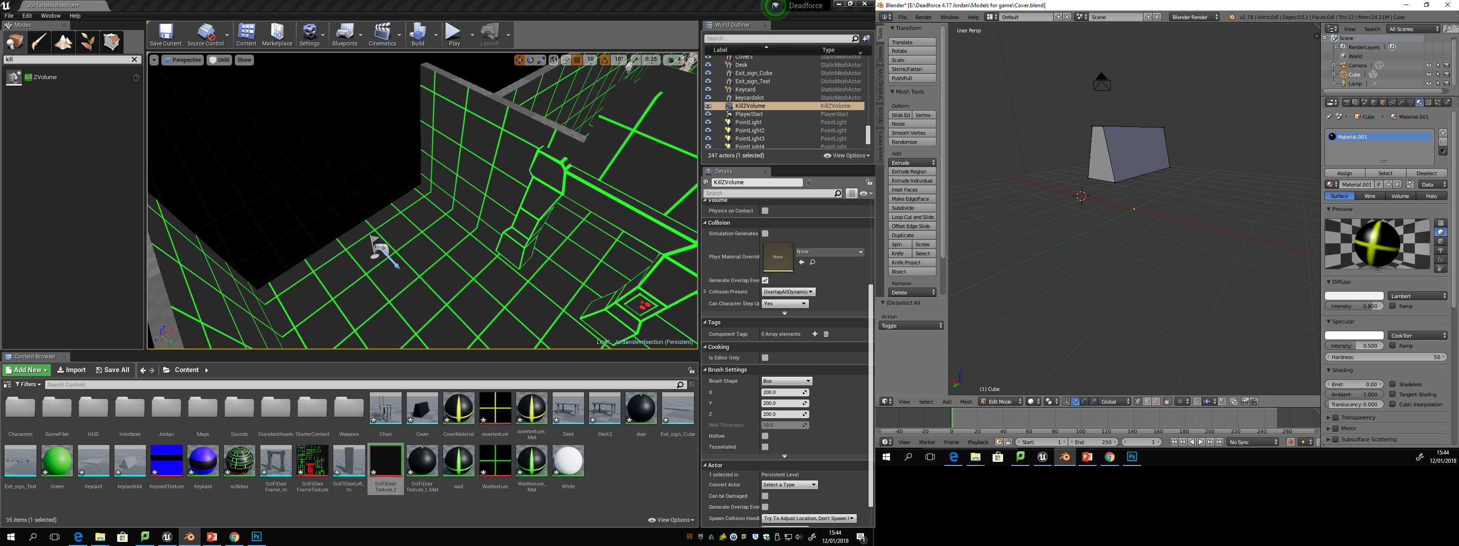
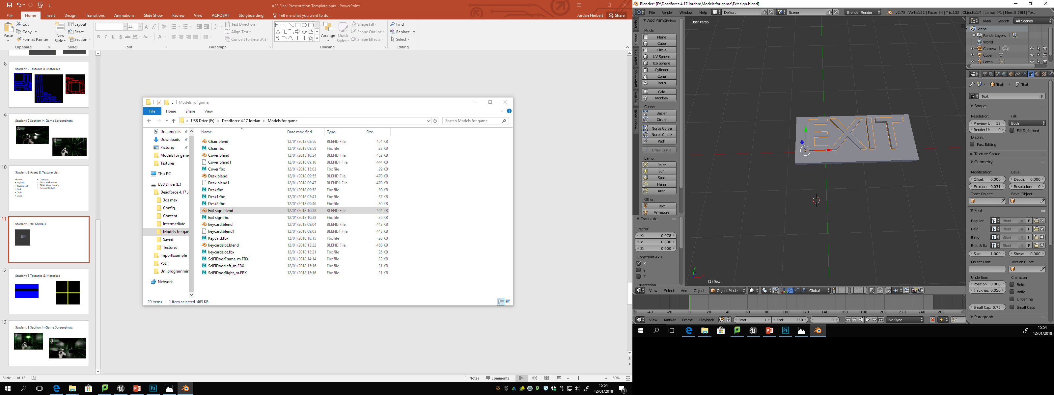
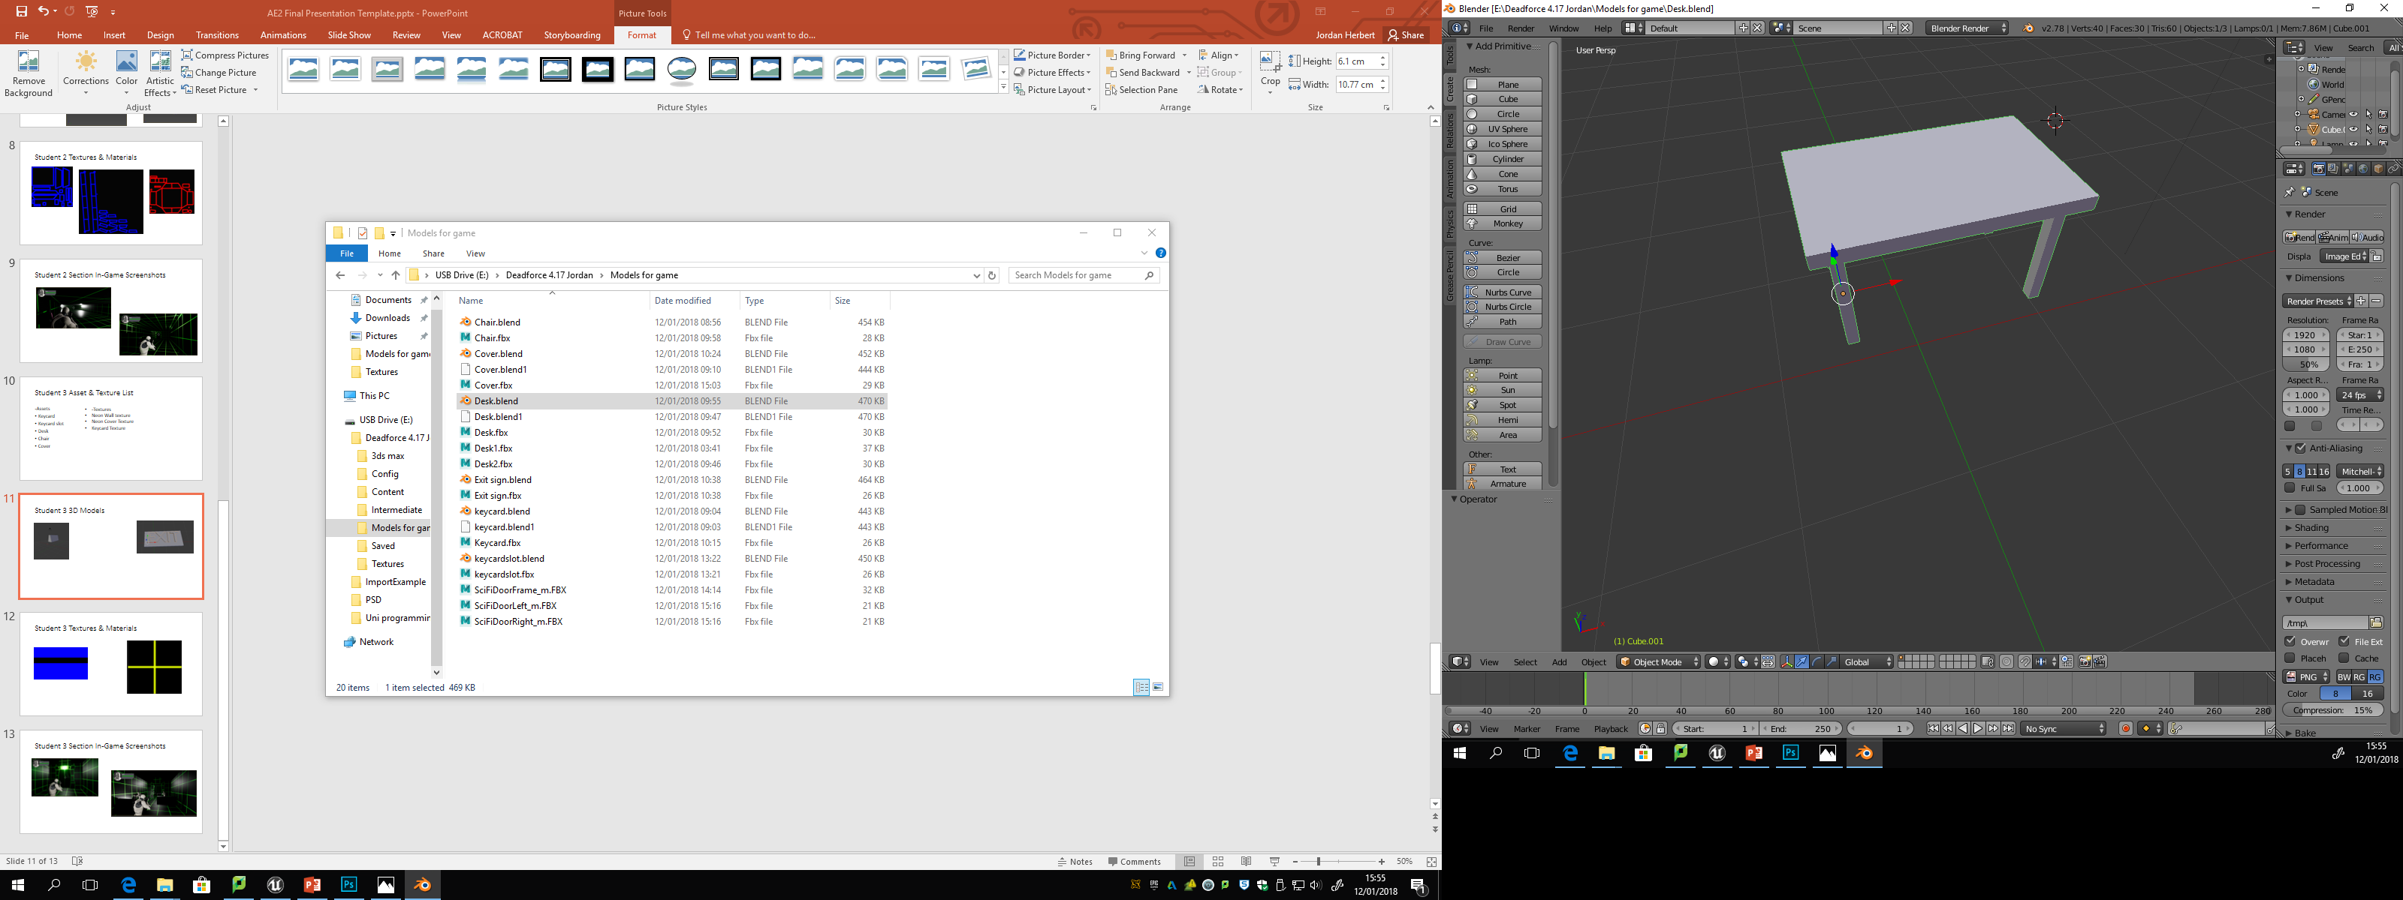
Jordan’s 3D Models

Slide 12
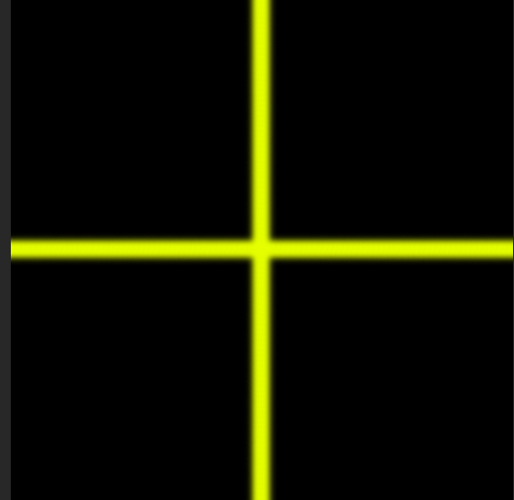

Jordan’s Textures & Materials

Slide 13
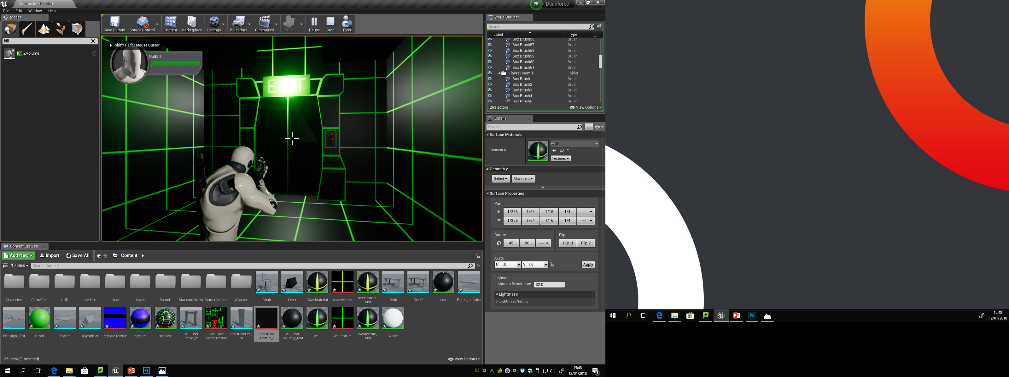
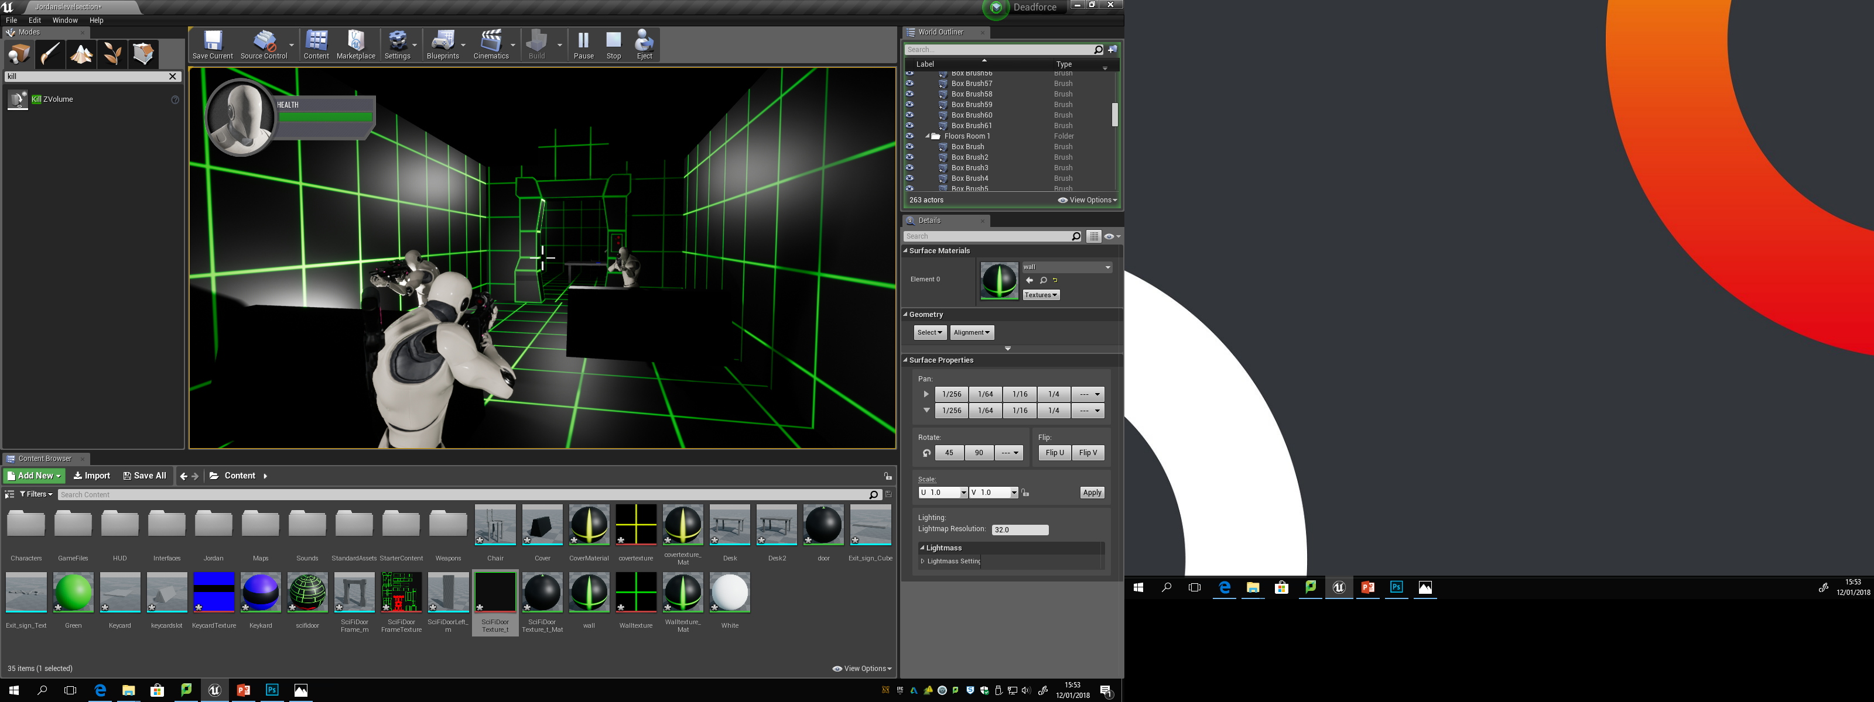
Jordan’s Section In-Game Screenshots

